Slide 1

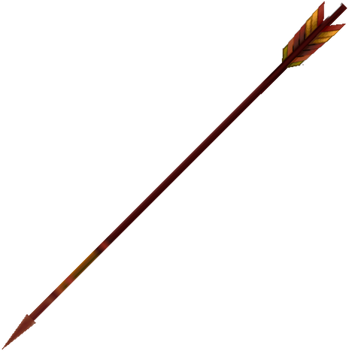


MINOR PROJECT PRESENTATION
Title: – Automatic Weaponized System
PRAGYASTRA
By : Amol Sharma (2020a3r021)
Harsh Singh (2020a3r013)
Mehak (2020a3r007)
Rashi Khajuria (2020a3r001)
Model Institute of
Engineering & Technology
Notes:
Presentation slide for courses, classes, lectures et al.

Slide 2
CONTENT
Problem statement
Solution
Components required
Architecture diagram
Interaction model
Data processing workflow
Annotated gun

Slide 3
Prototype images: multiple perspectives
Phases of our project
Project demonstration
Team pragyastra
Further advancements
References

Slide 4
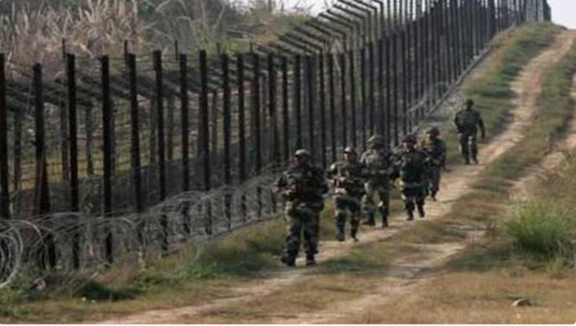
PROBLEM STATEMENT
Protecting our expansive 10,000 km border demands innovative technology to enhance human surveillance, prioritizing threat detection due to challenges in deploying soldiers across the entire border for complete coverage.
Figure 1 : Border Area

Slide 5
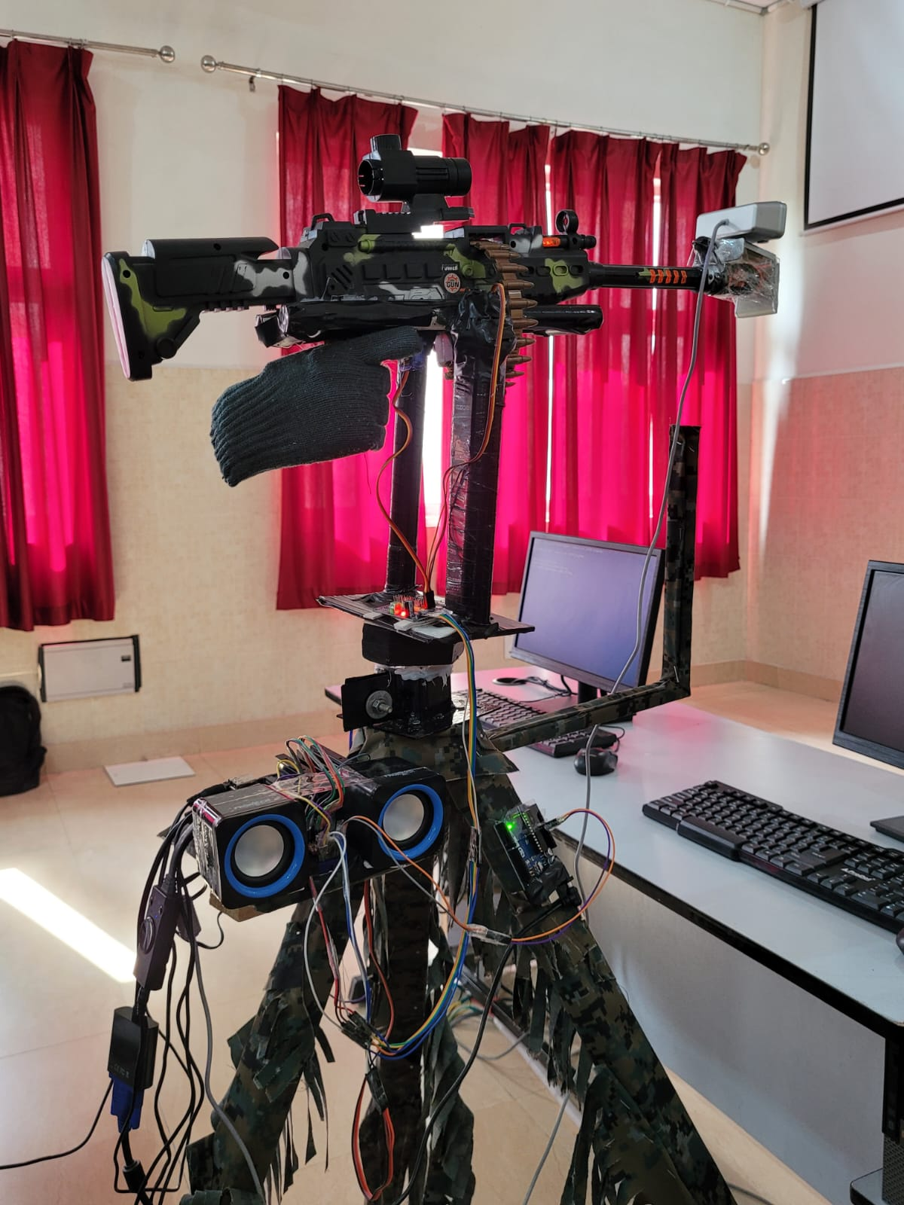
SOLUTION
AI weapon system
Features of the AI gun:
Semi- automatic mode
Human and weapon class
Night vision cameras
Buzzer sound
Figure 2 : AI enabled gun

Slide 6
COMPONENTS REQUIRED
S.NO | ITEMS | SPECIFICATION | COST (in Rs)
1 | Jetson Nano | The Jetson Nano is a small powerful computer designed for AI and robotics applications | 20,000
2 | Stepper Motor | Stepper motors convert electrical pulses into incremental rotational movement allowing precise control | 1800
3 | A4988 Driver | Stepper motor driver enabling precise control and used for micro stepping | 400
4 | MG955 Servo motor | The MG995 servo motor operates between 4.8-7.2V and offering a 180-degree rotation angle. | 500

Slide 7
S.NO | ITEMS | SPECIFICATION | COST (in Rs)
5 | CCTV Camera | A surveillance tool capturing video for security and monitoring purposes | 2000
6 | Gun | An arms system integrating artificial intelligence for enhanced firearm capabilities in targeting | 500
7 | Micro SD Card | SD cards are used in devices like Jetson Nano for portable storage, hosting OS. | 500
8 | PCA96855 Servo Driver | Used for precise movement of servo motor | 600
9. | DVR Convertor | A DVR is used in CCTV cameras to record, store, and manage surveillance footage for monitoring and analysis. | 900

Slide 8
S.NO | ITEMS | SPECIFICATION | COST (in Rs)
10 | Breadboard | It is used for easy circuit construction, testing, and modification for electronics projects without soldering or permanent connections. | 150
11 | Jumper wires | Connectors used to establish temporary electrical connections | 500
12 | Tripod Stand | A tripod stand provides stability and support for a gun, enhancing aiming precision | 500
13 | Miscellaneous charges |  | 2000
 |  | Total Cost | 30,350

Slide 9
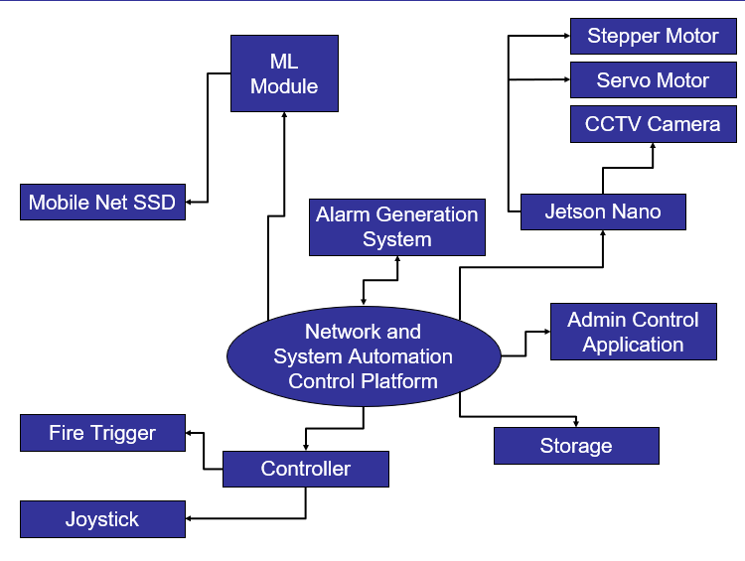
ARCHITECTURE DESIGN

Slide 10
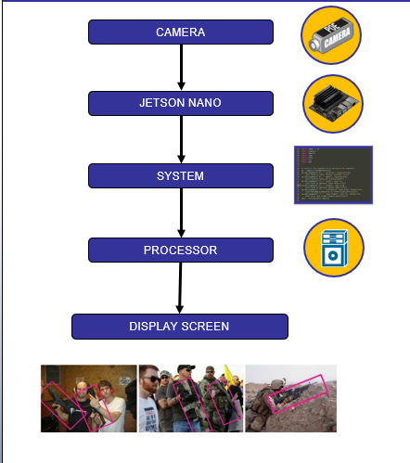
INTERACTION MODEL

Slide 11
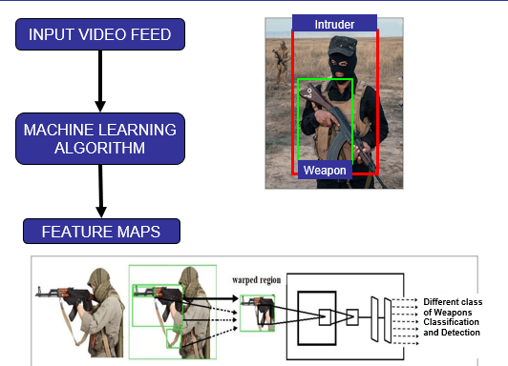
DATA PROCESSING WORKFLOW

Slide 12
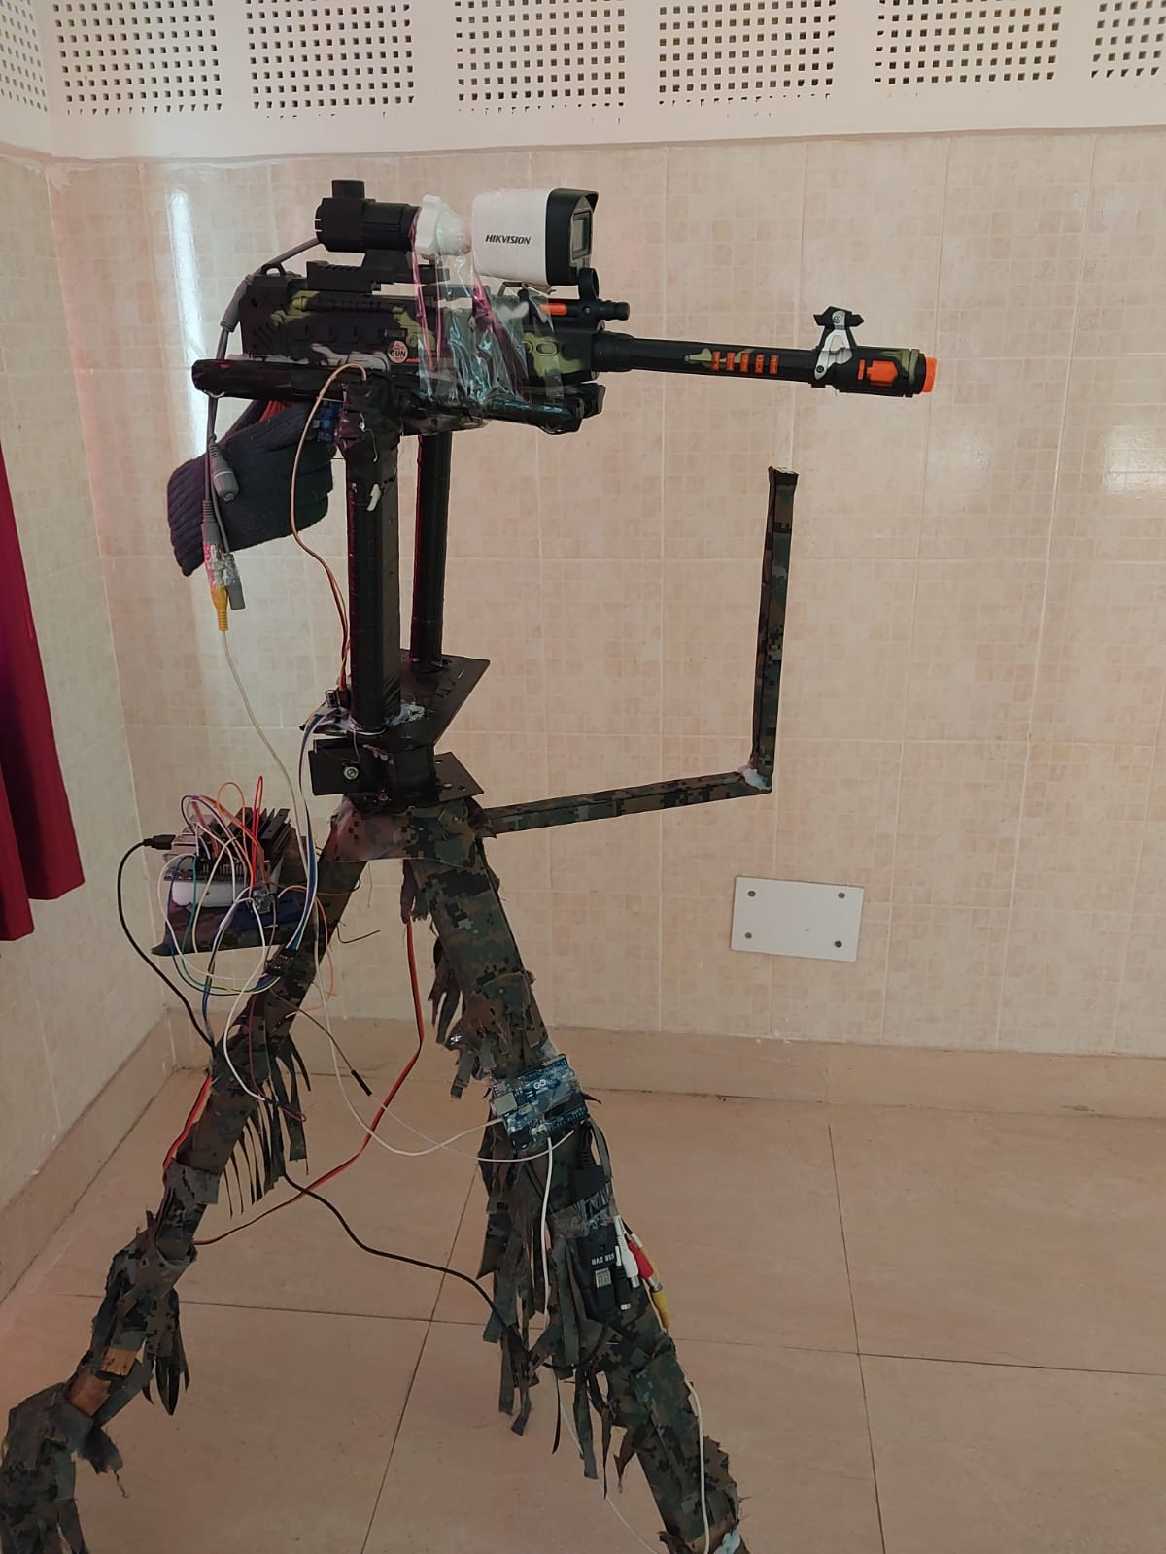
ANNOTATED GUN
Night Vision Camera
Servo Motor
Stepper Motor
Jetson Nano
DVR
Tripod Stand

Slide 13
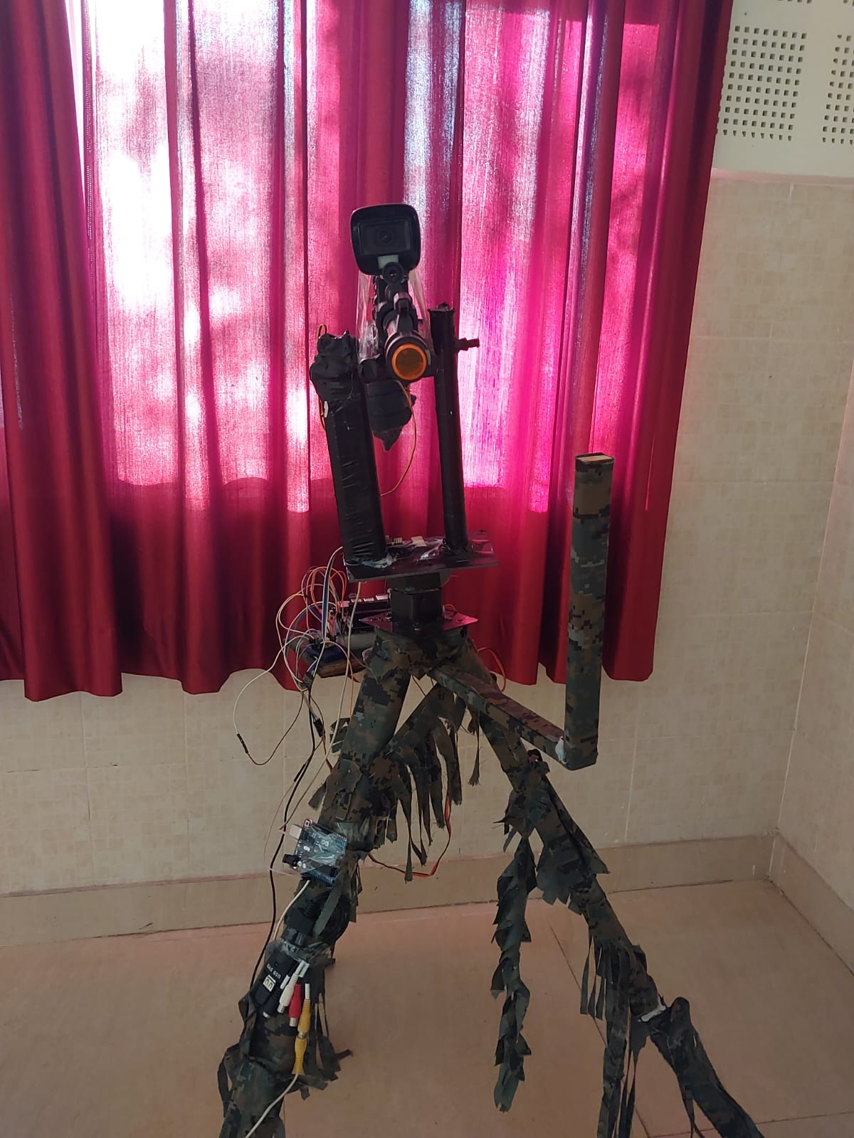
PROTOTYPE IMAGES: MULTIPLE PERSPECTIVES
FRONT VIEW

Slide 14
SIDE VIEW

Slide 15
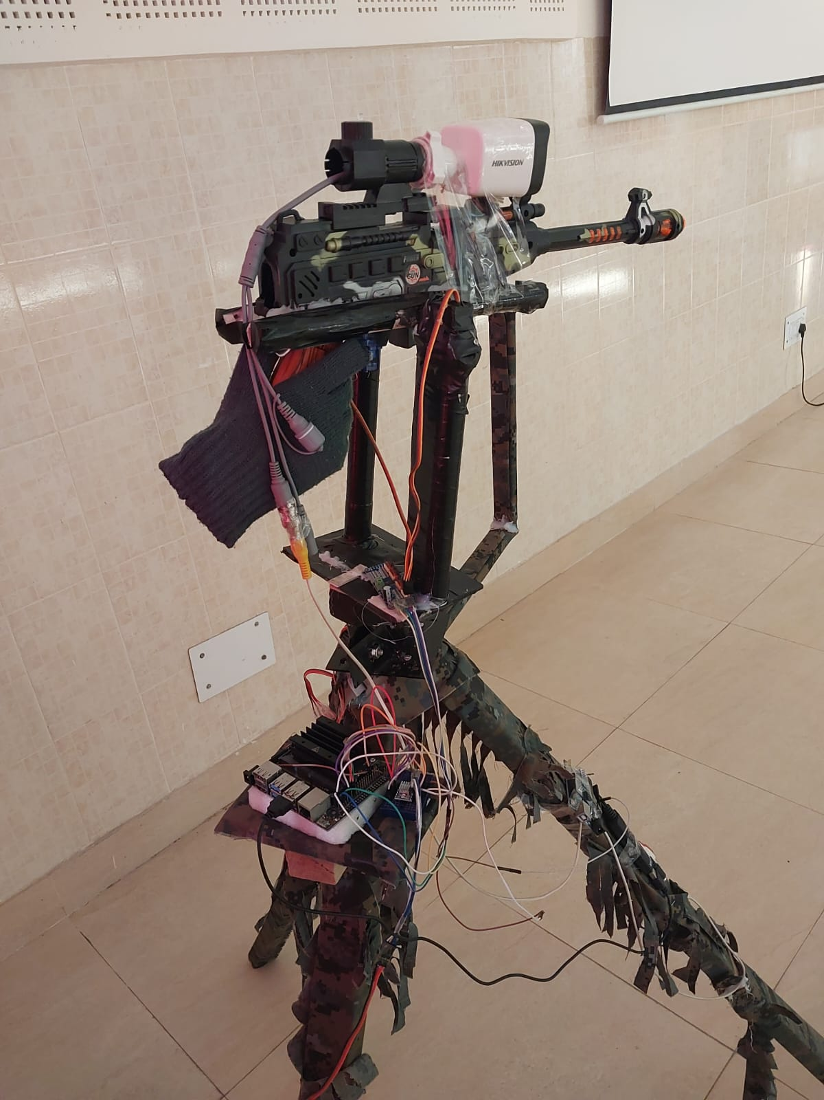
BACK VIEW

Slide 16
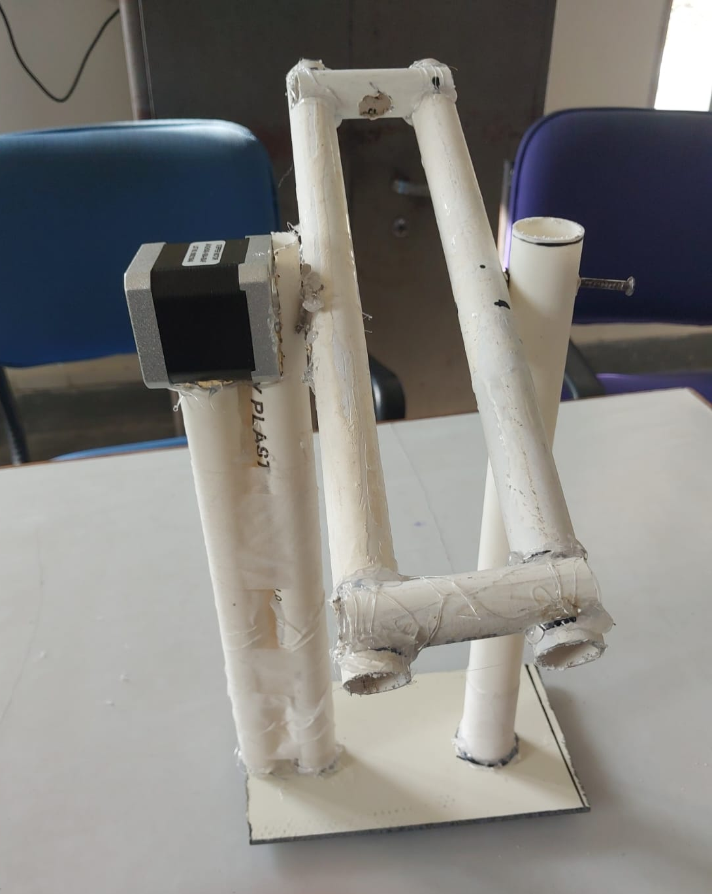
PHASES OF OUR PROJECT
We drafted the structural design of our upper model on paper and proceeded to create the prototype of upper segment accordingly.
Figure 3 : Upper segment design

Slide 17
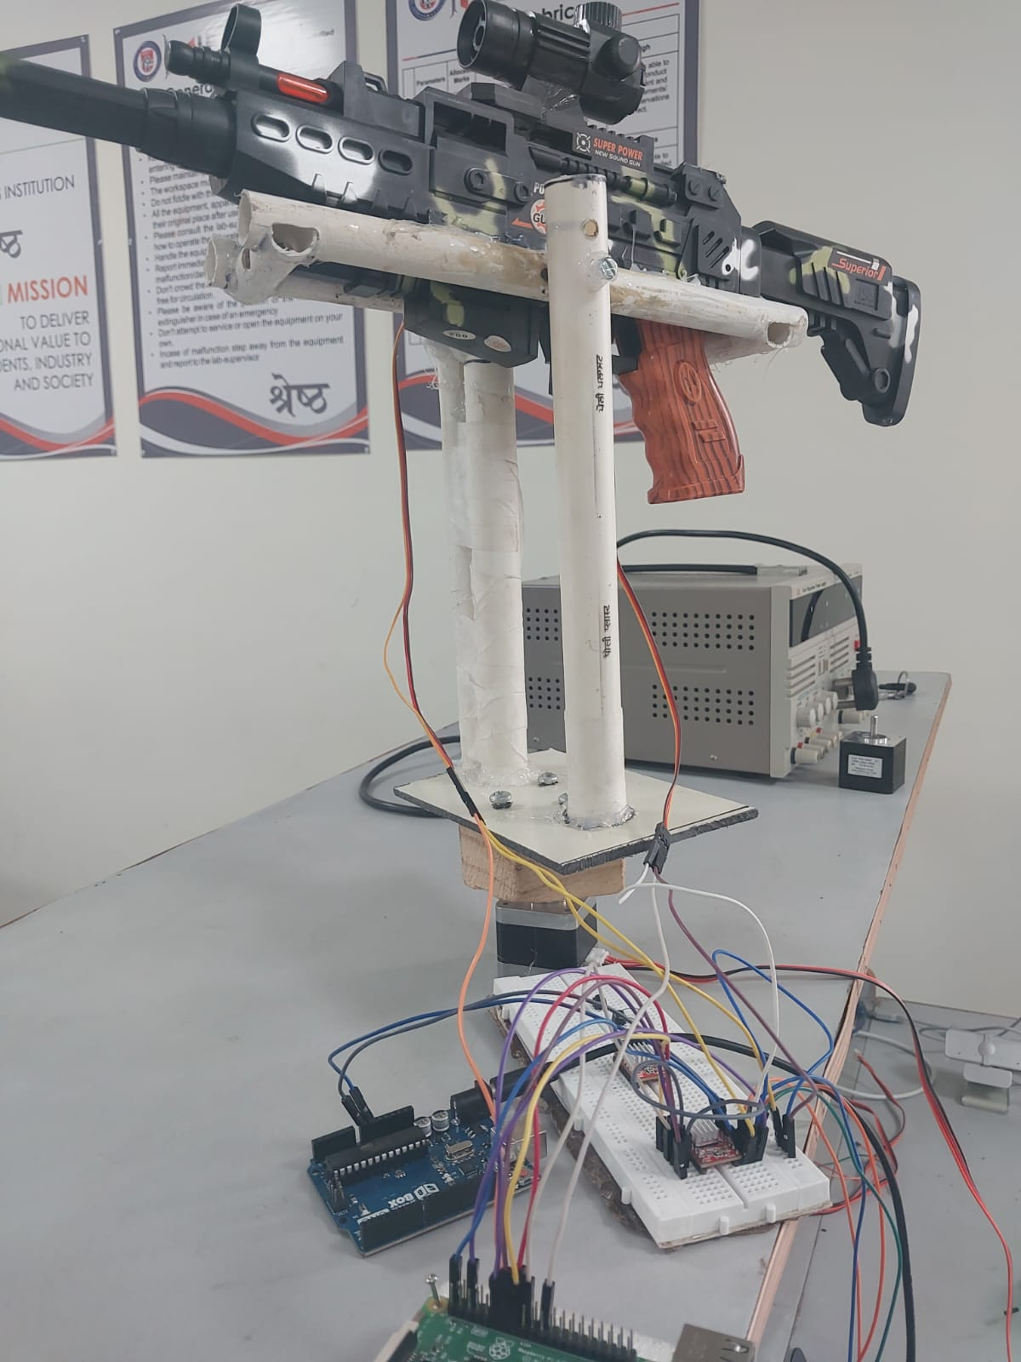
We have completed the wiring connections to test the motor functions enabling vertical (up-down) and horizontal (left-right) movement of the gun using manual buttons.
Figure 4 : Connections

Slide 18
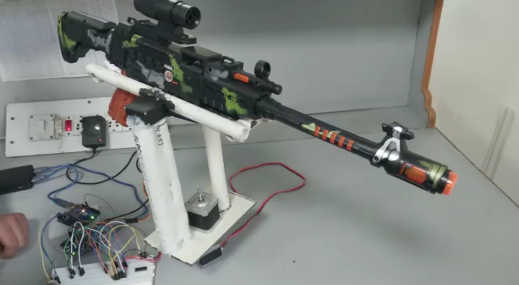
Demonstration of Manual button control for gun movement.

Slide 19
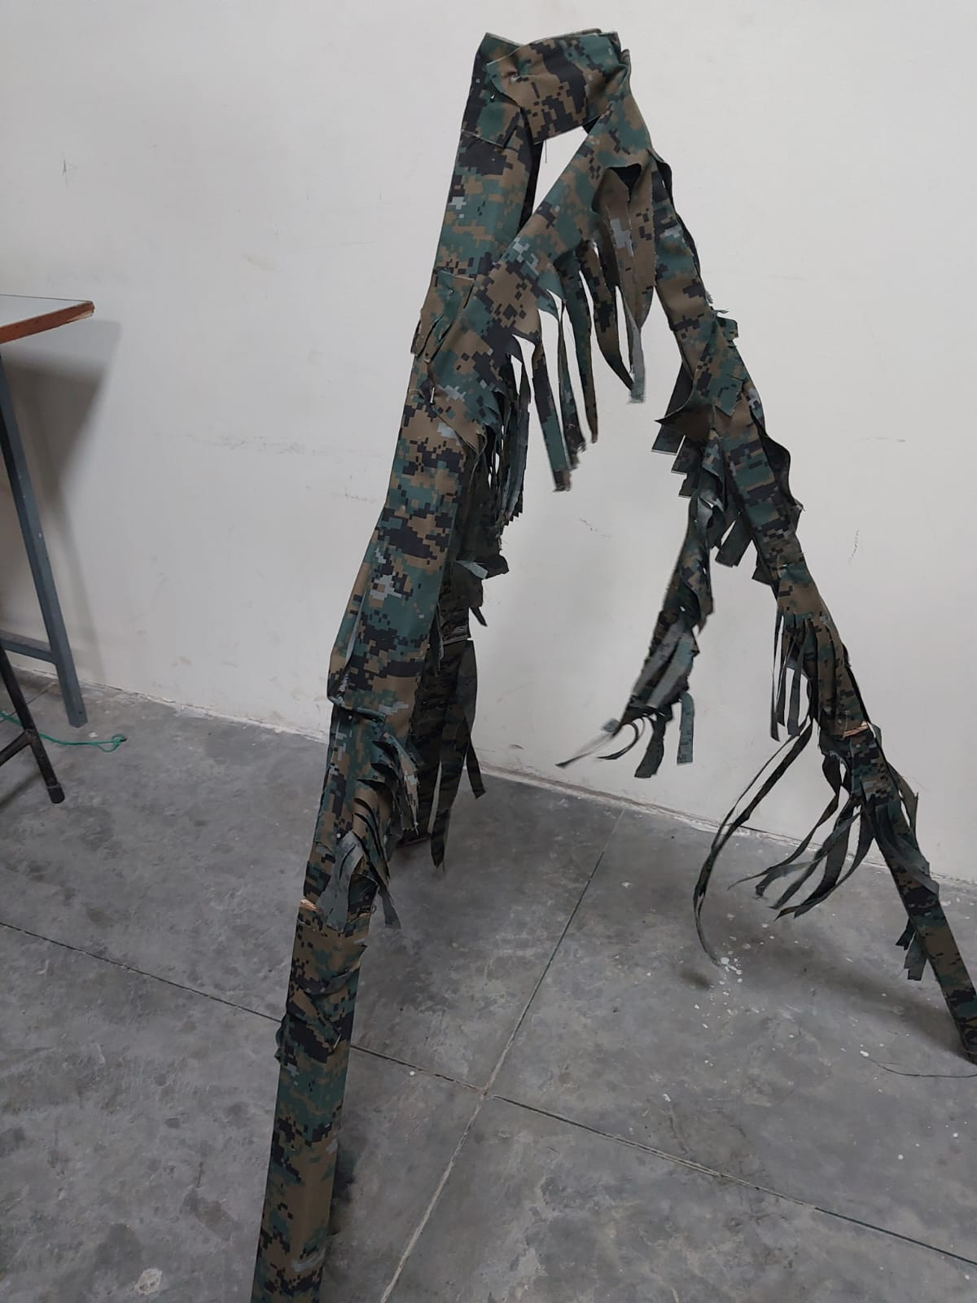
We have constructed a tripod stand in the workshop to enhance the gun mount's stability.
Figure 5 : Gun tripod stand

Slide 20
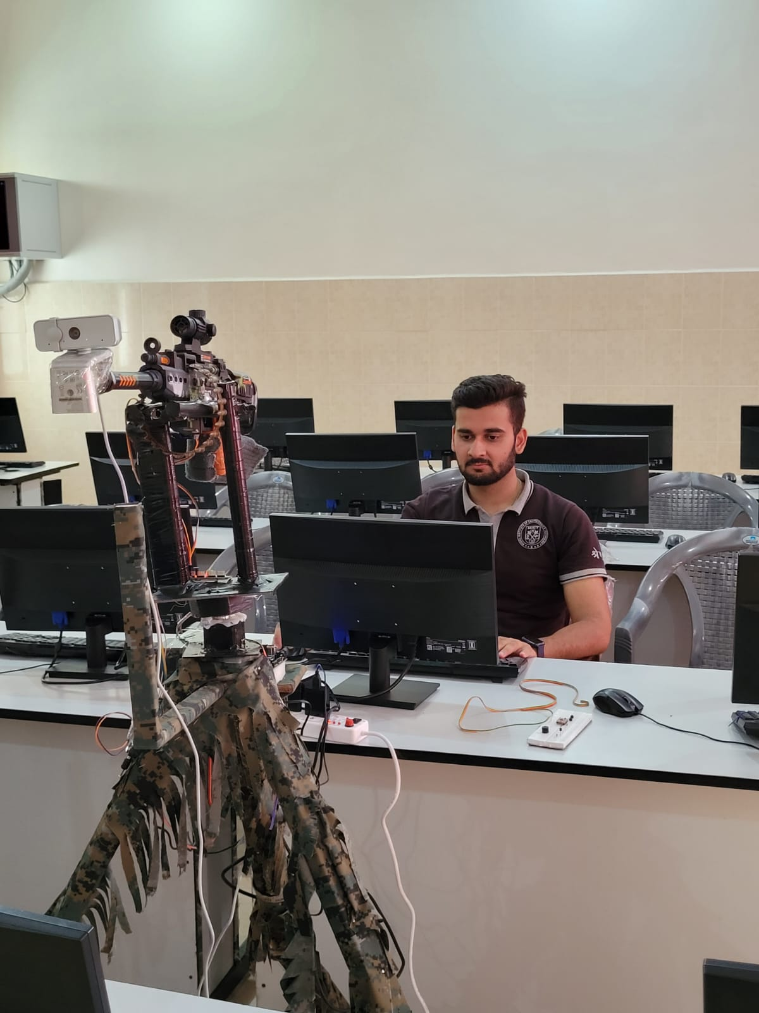
We combined the upper gun assembly with the tripod stand, then proceeded to conduct programming, testing, and trials using the Jetson Nano.
Figure 6 : Testing

Slide 21
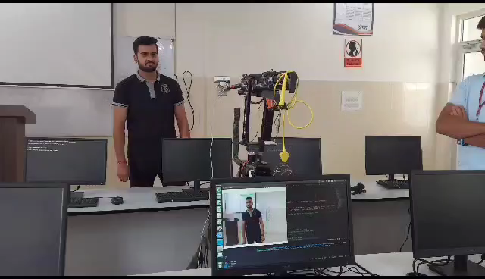
Testing Phase Video

Slide 22
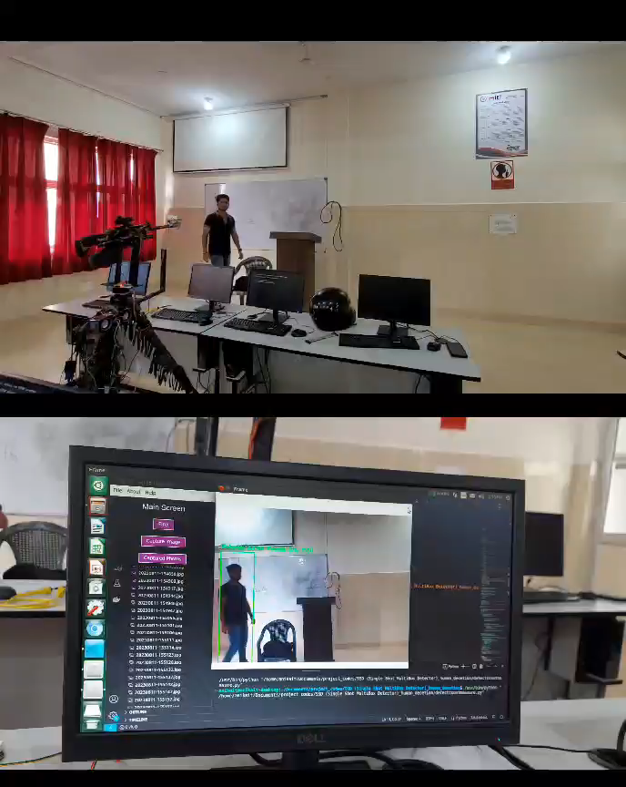
PROJECT DEMONSTRATION

Slide 23
FURTHER ADVANCEMENTS
Introduction of two new modes: Manual mode and Fully Automatic mode.
Replacement of MobileNet SSD with YOLOv8 model for enhanced object detection.
Expansion of weapon classifications for a broader range of weapon types.

Slide 24
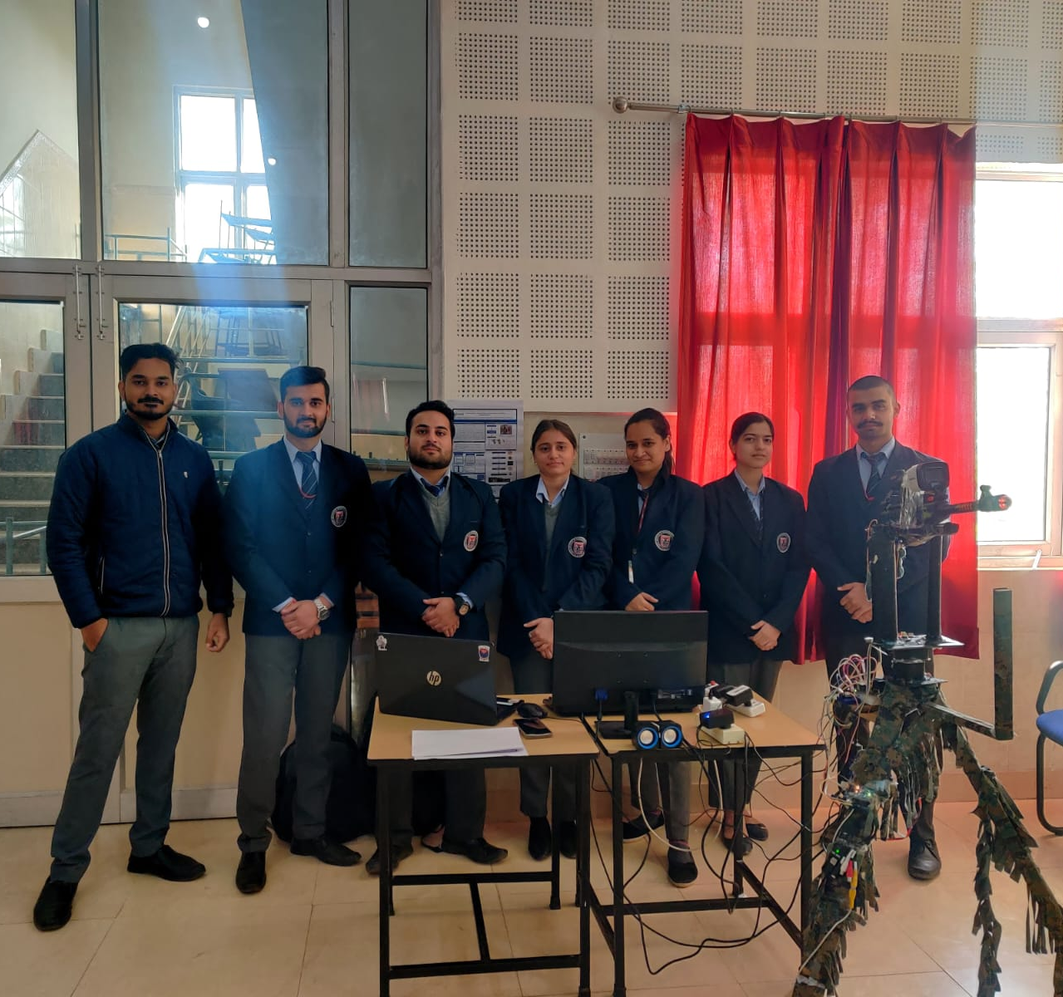
TEAM PRAGYASTRA

Slide 25
REFERENCES
[1] Ploumis, Michail. "AI weapon systems in future war operations; strategy, operations and tactics." Comparative Strategy 41.1 (2022): 1-18..
[2] Feldman, Philip, Aaron Dant, and Aaron Massey. "Integrating artificial intelligence into weapon systems." arXiv preprint arXiv:1905.03899 (2019).
[3] Abaimov, Stanislav, and Maurizio Martellini. "Artificial intelligence in autonomous weapon systems." 21st Century Prometheus: Managing CBRN Safety and Security Affected by Cutting-Edge Technologies (2020): 141-177.
[4] Süzen, Ahmet Ali, Burhan Duman, and Betül Şen. "Benchmark analysis of jetson tx2, jetson nano and raspberry pi using deep-cnn." 2020 International Congress on Human-Computer Interaction, Optimization and Robotic Applications (HORA). IEEE, 2020.

Slide 26

Thank You

